Slide 1
Data
Management & Visualization
Eng- Mohamed Khaled Idris
Eng- Mayar Swilam

Slide 2
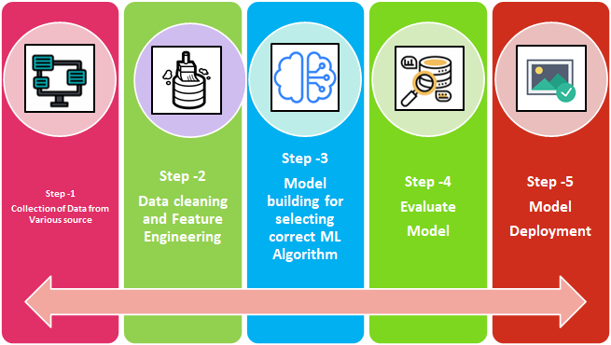
Review:

Slide 3
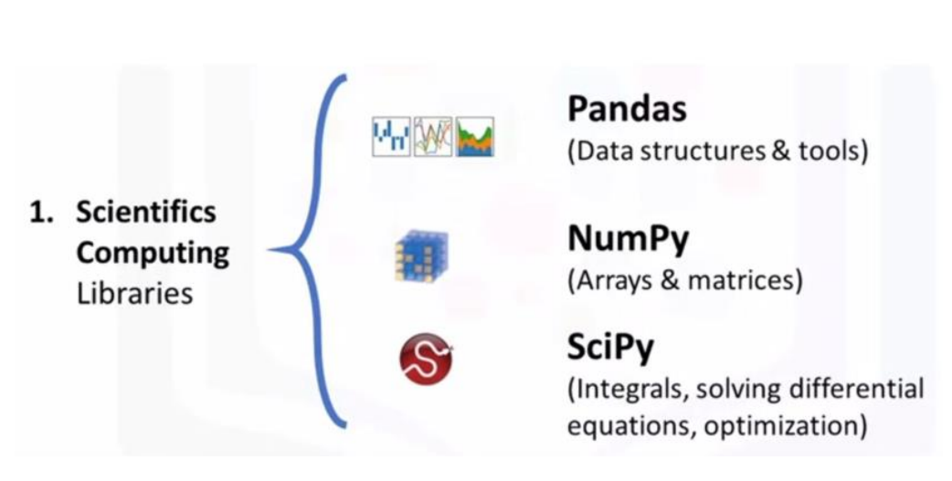
Python Libraries

Slide 4
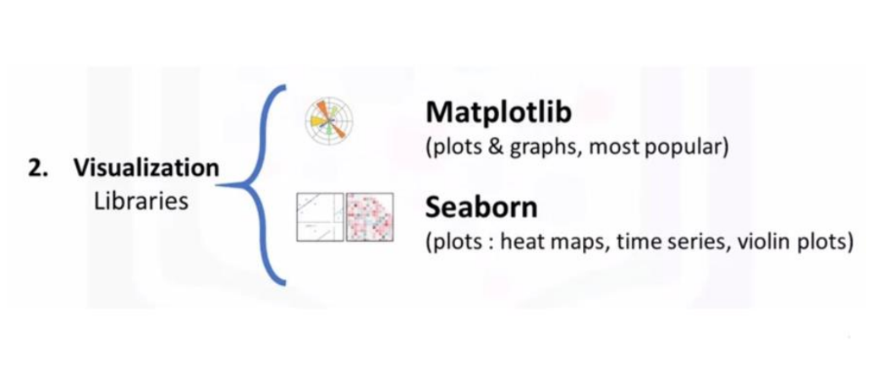
Python Libraries

Slide 5
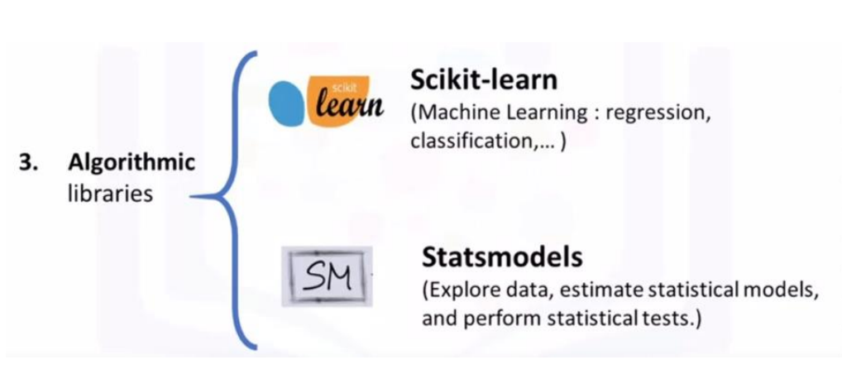
Python Libraries

Slide 6

Python Libraries
TENSORFLOW & PYTORCH

Slide 7
Data Management
In order to manage data through python, there are many ways to do it !
Also, you may need to do some mathematical operations to matrices, lists or any structure
You can simply manage your data as the same as SQL
HOW THEN ?
7

Slide 8
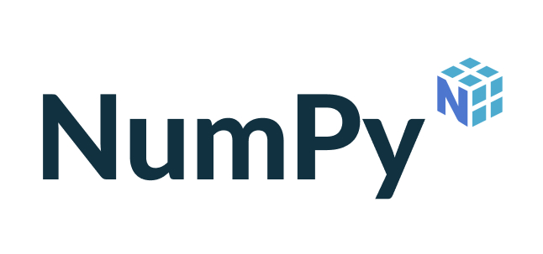

Slide 9

What is NumPy ?
NumPy is an open-source Python library that facilitates efficient numerical operations on large quantities of data.
There are a few functions that exist in NumPy that we use on pandas DataFrames.
For us, the most important part about NumPy is that pandas is built on top of it. So, NumPy is a dependency of Pandas.
9

Slide 10
NumPy Arrays
NumPy arrays are unique in that they are more flexible than normal Python lists.
They are called ndarrays since they can have any number (n) of dimensions (d).
They hold a collection of items of any one data type and can be either a vector (one-dimensional) or a matrix (multi-dimensional).
NumPy arrays allow for fast element access and efficient data manipulation.
10

Slide 11
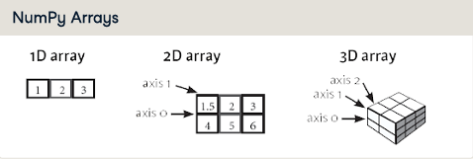

Slide 12
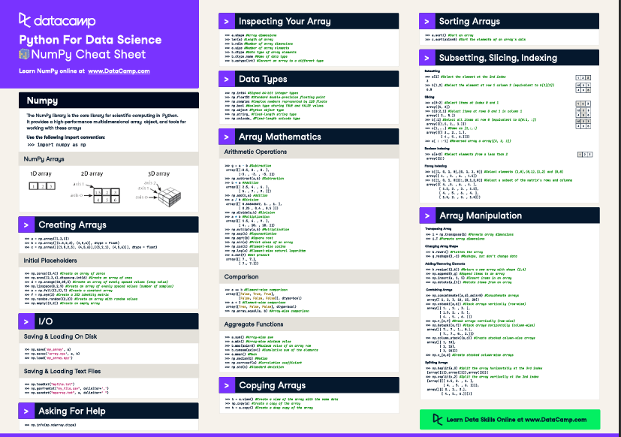

Datacamp Cheat Sheet (NumPy)
https://images.datacamp.com/image/upload/v1676302459/Marketing/Blog/Numpy_Cheat_Sheet.pdf
12

Slide 13


Slide 14
What is Pandas ?
Pandas is a very popular library for working with data (its goal is to be the most powerful and flexible open-source tool, and in our opinion, it has reached that goal).
DataFrames are at the center of pandas. A DataFrame is structured like a table or spreadsheet. The rows and the columns both have indexes, and you can perform operations on rows or columns separately.

Slide 15
DataFrame
A pandas DataFrame can be easily changed and manipulated. Pandas has helpful functions for handling missing data, performing operations on columns and rows, and transforming data.
If that wasn’t enough, a lot of SQL functions have counterparts in pandas, such as join, merge, filter by, and group by.
With all of these powerful tools, it should come as no surprise that pandas is very popular among data scientists.
15

Slide 16
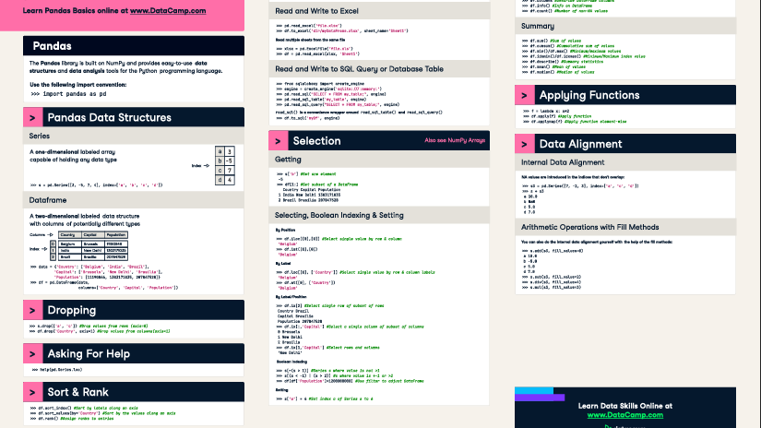
Datacamp Cheat Sheet
(Pandas)
https://images.datacamp.com/image/upload/v1676302204/Marketing/Blog/Pandas_Cheat_Sheet.pdf

Slide 17
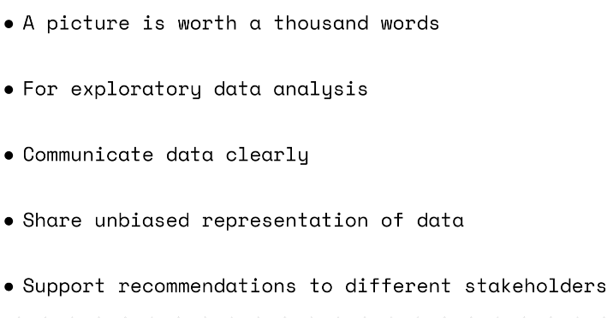
Why Visualization ?

Slide 18
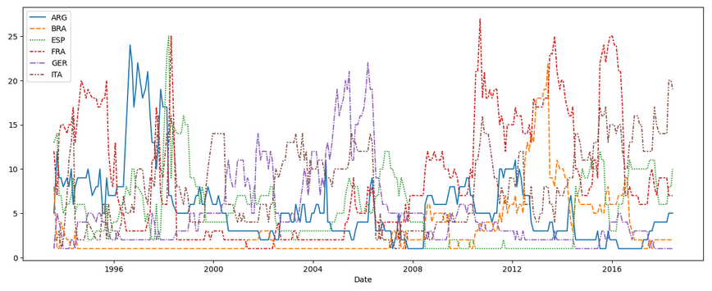
The important of Visualization
Considering only the years represented in the figure, which countries spent at least 5 consecutive years in the #1 ranked spot?

Slide 19
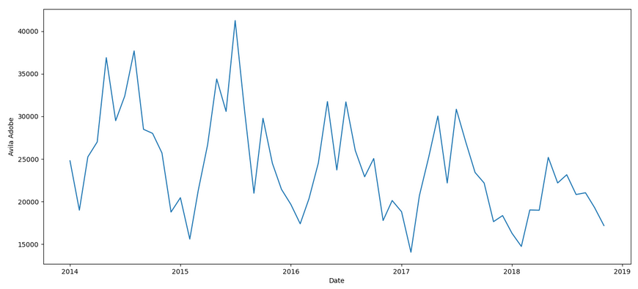
Does Avila Adobe get more visitors:
in September-February (in LA, the fall and winter months), or
in March-August (in LA, the spring and summer)?
Using this information, when should the museum staff additional seasonal employees?

Slide 20
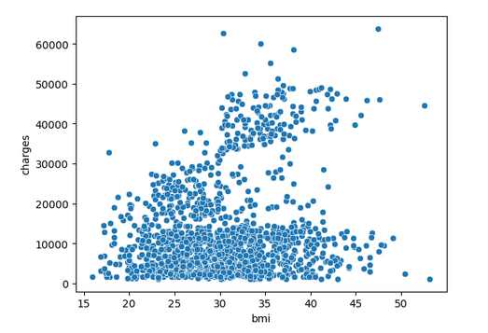
Is there any relation between Body mass Index and Insurance charges ?

Slide 21
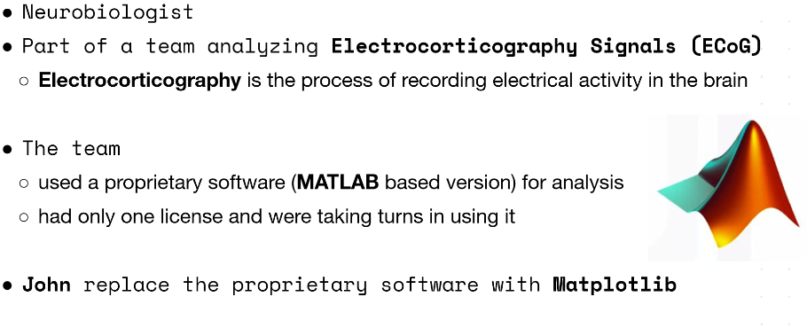
Matplotlib

Slide 22
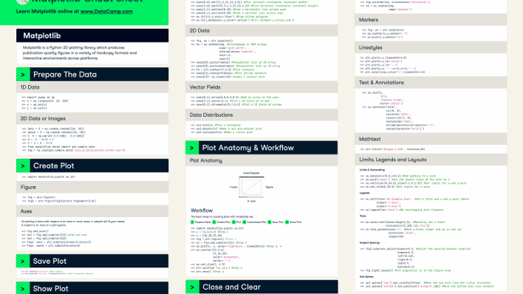
Datacamp Cheat Sheet (Matplotlib)
https://images.datacamp.com/image/upload/v1676360378/Marketing/Blog/Matplotlib_Cheat_Sheet.pdf
22

Slide 23

Questions

Slide 24


Thank You

